Slide 1
Thesis Project
Statistics and Data Science

Slide 2
Welcome
Thesis project committee
Marjolein Fokkema Chair of this committee, FSW - Methodology & Statistics
Michelle Krens Thesis administration
Carel Peeters WUR – Biometris
Alexander Dürre FWN - Mathematical Institute
Roula Tsonaka LUMC - Biomedical Data Sciences
Mark de Rooij EMOS / Statistics Netherlands, FSW – Meth & Stats

Slide 3
This morning
9.00 - 9.45:
Some general information on the second year
Information on the Thesis Project
General overview
Tips and advices
10.00-10.45
Presentation of the four groups who organize this master.

Slide 4
Thesis project: General aims
To gain experience as a working statistician/data scientist in a possible future working environment
To carry out a research project and produce a scientific manuscript of students’ original work.

Slide 5
The thesis preparation + project
Preparation of the thesis project (4EC)
Thesis project (30 EC)
Lectures, workshops
Introduction lecture
Write proposal
Find a “thesis working place” and supervisor
Carry out thesis project
Follow thesis working groups
Class on research integrity
Attend a thesis defense and ask a question
For external project: find a second StatDat supervisor
Give your supervisors the documentation for supervisors
Subscribe to Thesis Project course
Defend thesis
Submit proposal which should be approved by thesis committee and all supervisors
Class on reproducible research
Write thesis proposal which should include three practical working activities
Perform the practical activities in the working environment, and submit reflection forms
Write thesis
Class on scientific writing
10 weeks after starting the thesis project: midway evaluation meeting.
Organize thesis defense

Slide 6

Semester 3:
Introduction lecture
Workshop on research integrity MANDATORY
Workshop on reproducible research MANDATORY
Workshop on scientific writing MANDATORY
Visit a thesis defense MANDATORY
Find a place to conduct your thesis project, write thesis proposal and submit MANDATORY
Passed if you have finished these 5 items

Slide 7
Entry requirements
Entry requirement:
42 ECTS to start preparation of the thesis project.
60 ECTS to start the actual thesis project.
Completed all courses (≥ 90 EC, except thesis project) to attend the final examination (thesis defense).

Slide 8
Preparation: Mandatory workshops
FALL (may change, we will inform you through Brightspace and MyTimetable)
Mon Sept 30 2024 09:00-10:45 Introduction
Mon Sept 30 2024 09:00-10:45 Research Integrity
Mon Oct 28 2024 09:00-10:45 Reproducibility
Mon Nov 18 2024 11:00 09:00-10:45 Scientific Writing

Slide 9
Preparation: Attend a thesis defence
Defense dates & times will be posted on Brightspace
Go to defence
Get form signed by session chair
Write a very short report and submit on Brightspace

Slide 10

Semester 3:
Written by the student, under supervision of supervisor(s).
Format can be found on Brightspace:
Description of aims and research activities.
Detailed time plan.
Intended frequency of meetings with supervisor(s).
Planned workplace activities.
Statement that the supervisors and student will apply good scientific practices.

Slide 11
Thesis project: different possibilities
Type of project:
Academic project on a methodological topic.
Applied statistical project, on master level, where a non-standard data analysis is carried out.
Combination of both (start with a more applied internship, related academic topic for writing thesis).
Location of project
Internal: at one of the groups of the Stat & Dat master (Methods and Statistics, Psychology, LU Medical Center, Mathematical Institute, Wageningen-Biometris).
External: at another institute, university, industry, governmental organization.

Slide 12
Supervisors
Project at departments affiliated with master
Supervisor is a staff member with a PhD.
External project
A local / external supervisor, preferable a Statistician or Data Scientist with a PhD.
A second / internal supervisor from Statistics & Data Science. Note: the student is responsible for finding a second supervisor.
Projects should fit into the curriculum and expertises of the Stat & Data Science master. Topics beyond statistics within the life and behavioral sciences may not be possible. If in doubt, consult with one of the thesis committee members, and/or your prospective internal supervisor.

Slide 13
Semester 4:
Carry out thesis project
30 ECs equals ±21 weeks of full-time study.
To do:
participate in activities in your working environment
participate in thesis working groups
carry out the research of the thesis proposal and write a thesis
present and defend your thesis

Slide 14
Workplace activities
Get experience as a working statistician or data scientist
Participate in some day-to-day activities
To develop soft skills such as communication, presenting, leadership, organizing
To get more insight in the working place, and to think about your future career path.
You need to select 3 activities, and write a reflection report for each activity.
Daily supervisor will grade with pass/fail.
Need to be submitted before (or at the same time as) the thesis is submitted.

Slide 15
Examples of activities
Participating in journal clubs, research meetings and non-research meetings.
Create an organization chart (organogram).
Make a visualization and/or summary of results of your project for end-users.
Create a tutorial for a method you developed.
Organize or participate in a workshop.
Attend a career event in the field of statistics or data science.
Explain results of statistical analyses to non-statisticians or non-data scientists.
Perform an interview regarding wishes of stakeholders.
Give a presentation at the working place.
Write a letter of application/CV and let it be reviewed by the Human Resources department.
Apply for a job opening at the company you are writing your thesis at.
See Brightspace for more details.

Slide 16
Thesis working groups
In the 4th semester.
Organized at the university.
Students share work and work experiences.
Supervised by a Stat & Dats Science staff member.
Groups meet monthly on Friday mornings.
Start in September and February.
Mandatory to attend 4 out of 5 sessions.
Every session has a specific theme, but will leave enough time to focus on miscellaneous topics suggested or encountered by students.
Specific themes include: Running analyses on a high-performance computing cluster, peer-feedback on written parts of your thesis, creating tables and figures, presenting.

Slide 17
Midway meeting
10 weeks after start of the project, discuss progress with all supervisors:
What has been done so far?
Also: working place activities and skills acquired
How is writing going?
Ideally you should have started. For example, by written (draft of) the Introduction, overview of methods being used, some preliminary results.
Detailed planning of the remaining parts of the project.
Aims and objectives may need adjustment to be attained within project duration!
Plan the midway meeting at the start of your project!

Slide 18
Thesis and graduation
Thesis requirements are on Brightspace.
Procedures for graduation are on Brightspace.
Preparing the thesis defense should start at least 6 weeks before the intended date of defense.

Slide 19
All information on Brightspace
Projects are listed on Brightspace
A document with all information
AND INFORMATION FOR SUPERVISORS

Slide 20
Some advice

Slide 21
How to find a project and supervisor(s)
Check Brightspace for projects.
Ask one of your teachers.
Ask the contact persons of the thesis project committee.
Get inspiration by looking at old theses in the thesis repository.
Find a project yourself inside or outside of University Leiden.
Start on time!

Slide 22
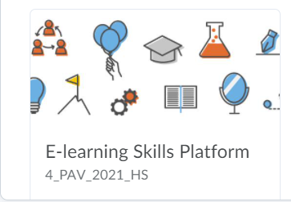
Learning skills platform
For every student at the faculty of Science.
Information, guidelines, tips and tricks on seven skill domains.
Research
Before presenting and writing.
Presentating.
Writing.
Collaboration.
(peer) feedback
Personal and professional development
The platform is accessible via the link: https://brightspace.universiteitleiden.nl/d2l/le/discovery/view/course/27150

Slide 23
Time plan
Present a feasible time schedule of your activities.
Indicate what elements can be cut / reduced if necessary.
Note that 30 EC corresponds to 21 weeks full time work.
Make a detailed plan (week by week).
At each supervisor-student meeting, compare progress with plan. In case of discrepancies, discuss how to adjust.
Be aware that writing takes time (and therefore start early writing drafts).

Slide 24
Meeting with supervisor
Make clear arrangements.
Preferably meet at least weekly at a fixed time.
In case of external project, also arrange meetings with second supervisor.

Slide 25
More information
Career service https://careerzone.universiteitleiden.nl/en/career-services/science/
Academic language center has courses (not free of charge)
Presenting: https://www.universiteitleiden.nl/en/language-centre/courses/english/eap-presenting-for-masters-students
Writing: https://www.universiteitleiden.nl/en/language-centre/courses/english/english-for-academic-purposes-writing
Writing coaches

Slide 26
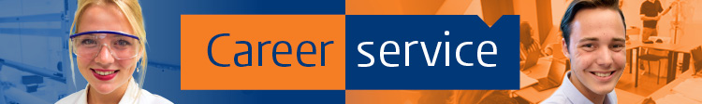
What or who is Science Career Service
Science Career Service..
..strives to support students in making effective decisions on their study & career
Study choices: Which minor / Master / Internship to choose
Application skills: How to write a CV / Application letter / LinkedIn Profile
Career Orientation: Internship – Career possibilities /Job market information

Slide 27
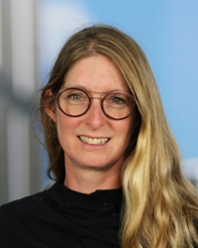



Team Science Career Service
Ilse Huijskens, PhD - Career Advisor
Biotechnology
PhD at University of British Columbia, Canada
Postdoctoral Researcher at LACDR, W&N
6,5 years Recruitment in Life Sciences and International Education
Role in team:
Career Orientation in curriculum at Science Faculty
Career advice | Individual counseling | Workshops | Training
Notes:
Voorstellen
Korte voorstel ronde, waarbij iedereen zijn/haar studie en jaar benoemt en – wat hoop jij uit deze workshop te halen?
Verwachtingen stellen: deze workshop geeft je een begin om voor jezelf beroepen en werkgevers in kaart te gaan brengen, een netwerk aan te spreken en uit te gaan bouwen.
In deze workshop hopen we dat je gaat nadenken over jouw profiel en en bieden we je handvatten om voor jezelf beroepen en werkgevers in kaart te gaan brengen, een netwerk aan te spreken en uit te gaan bouwen.

Slide 28
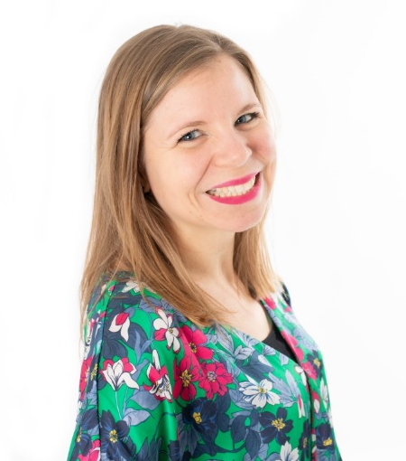
Team Science Career Service
Annemarie Loeters, MSc - Career Advisor
MSc Human Resource Studies, Tilburg University
Post-HBO Career Coaching diploma
7 years of recruitment experience (technicians, internationals)
Role in team:
Direct Service to students at Science Faculty
Career advice | Individual counseling | Workshops | Training
Notes:
Voorstellen
Korte voorstel ronde, waarbij iedereen zijn/haar studie en jaar benoemt en – wat hoop jij uit deze workshop te halen?
Verwachtingen stellen: deze workshop geeft je een begin om voor jezelf beroepen en werkgevers in kaart te gaan brengen, een netwerk aan te spreken en uit te gaan bouwen.
In deze workshop hopen we dat je gaat nadenken over jouw profiel en en bieden we je handvatten om voor jezelf beroepen en werkgevers in kaart te gaan brengen, een netwerk aan te spreken en uit te gaan bouwen.

Slide 29
Direct Service to Students
Individual Consultation
Consultation (Phone): Thursdays 12.30-13.30; for short questions
Individual (online) consults: 45 min. via Teams
Make an appointment online via Science Career Service homepage on the LU Careerzone
Online Advice
Feedback on CV and Application letter via career@science.leidenuniv.nl
Online information https://careerzone.universiteitleiden.nl/
Workshops en Career Colleges (NL/ENG)
Sign up via: https://careerzone.universiteitleiden.nl/en/career-services/science/
Workshops: CV and Cover Letter, LinkedIn en Job Interview,
How to network at BSPE/BBM
Career Colleges: Working as a Researcher, Working as a Consultant,
Working as an Educator, and Working as a Data Scientist

Slide 30
Thesis preparation + project
Preparation of the thesis project (4EC)
Thesis project (30 EC)
Lectures, workshops
Introduction lecture
Write proposal
Find a “thesis working place” and supervisor
Carry out thesis project
Follow thesis working groups
Class on research integrity
Attend a thesis defense and ask a question
For external project: find a second StatDat supervisor
Give your supervisors the documentation for supervisors
Subscribe to Thesis Project course
Defend thesis
Submit proposal which should be approved by thesis committee and all supervisors
Class on reproducible research
Write thesis proposal which should include three practical working activities
Perform the practical activities in the working environment, and submit reflection forms
Write thesis
Class on scientific writing
10 weeks after starting the thesis project: midway evaluation meeting.
Organize thesis defense

Slide 31
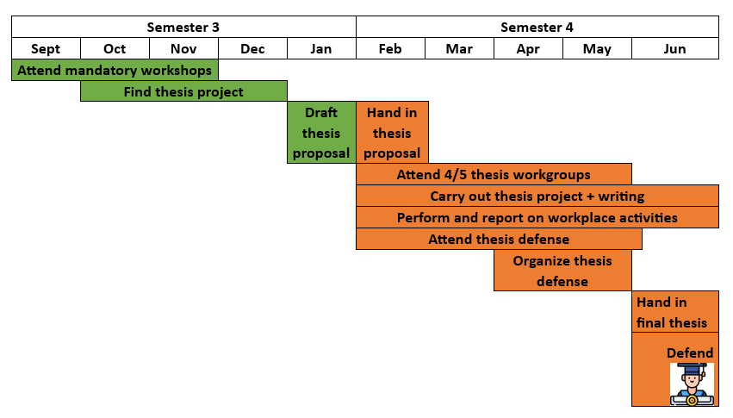
Thesis preparation + project
Attend thesis defense

Slide 32
Thesis project
Please let us know if things are unclear.
Also if you contacted someone from one of the “available projects”, but the project is not available anymore!
All suggestions for improvement are welcome

Slide 33
Questions?

